Slide 1

Peaceful Places: Vacation Rental Website
Sharayu Mahajan 22107051
Kalpana Mohanty 22107059
Rishi Mane 22107063
Avdhoot Virkar 22107064
Project Guide
Mr. Vaibhav Yavalkar

Slide 2
Outline
Introduction
Literature Survey of the existing systems
Limitations of the existing systems
Problem statement
System Design
Technologies and methodologies
Implementation
Conclusion
References

Slide 3
INTRODUCTION
PeacefulPlaces is a web stack-based vacation rental website inspired by Airbnb.
Offers a seamless experience to find and book accommodations.
The platform provides personalized hotel suggestions to match customer needs, ensuring an effortless booking process.
Utilizes advanced algorithms to search & sort hotels.
Finding the perfect stay is simple and quick.
1.1 Motivation
Personalized recommendations enhance guest satisfaction by providing tailored and memorable stays.
Leveraging data insights ensures early, accurate matches to guest preferences, resulting in a seamless and enjoyable booking experience.

Slide 4
INTRODUCTION
1.2 Objectives
To efficiently sorting places based on reviews and ratings, recommendation algorithm is used.
To offer personalized assistance through real-time, options-based guidance.
To provide map integration , geolocation services or mapping API’s are used.
To provide seamless and secure property listing management.

Slide 5
Literature Survey of the existing system
Sr. No | Title | Author | Year | Outcomes | Methodology | Demerits
1 | Performance Analysis of Deep Approaches on Airbnb Sentiment Reviews | Muhammad Raheel Raza, Walayat Hussain, Asaf Varol | June 23,2022 | .The website analyzes Airbnb reviews & can help hosts understand customer feedback and improve their services effectively. | Three Deep Learning models:RNN, LSTM, and GRU are used for sentiment analysis. | Has limited dataset scope & generalizability.

Slide 6
Literature Survey of the existing system
Sr. No | Title | Author | Year | Outcomes | Methodology | Demerits
2 | Analysing TripAdvisor reviews of tourist attractions in Phuket, Thailand | Viriya Taecharungroj, Boonyanit Mathayomchan | 2019 | Analyzes 65,079 TripAdvisor reviews of tourist attractions in Phuket | Support latent Dirichlet allocation (LDA) and naïve Bayes modeling | Focus on a specific timeframe for attraction dimension, potential biases in online review data

Slide 7
Literature Survey of the existing system
SrNo | Title | Author | Year | Outcomes | Methodology | Demerits
3 | A Systematic Literature Review of Rural Homestays and Sustainability in Tourism | Zain ul abedin Janjua, Gengeswari Krishnapillai, Mobashar Rahman | April 8,2021 | Highlights the need for more focused research on rural homestays and sustainability,emphasizes the potential of homestays to enhance sustainable rural tourism. | Support SLR methodology, PRISMA flowchart | Only 51% of studies focused on homestays as an independent research area, indicating a significant gap in the literature. Critical topics like branding, entrepreneurship,& ICT competency related to homestays are rarely addressed.

Slide 8
Limitation of Existing System
No In-Platform Navigation Assistance:Airbnb does not offer built-in map navigation, requiring users to use external apps. PeacefulPlaces includes map integration, allowing users to locate properties and navigate to nearby attractions within the platform.
No Real-Time Personalization: TripAdvisor offers generalized recommendations, without real-time customization. PeacefulPlaces provides personalized recommendations based on user preferences and past behavior, improving the relevance of suggestions.
Lack of Personalized Recommendations: Traditional homestay platforms generally offer broad recommendations. PeacefulPlaces personalizes suggestions based on user preferences, needs, and past interactions, enhancing the relevance of the options presented.

Slide 9
Problem statement
Effective travel planning depends on the ability to sort accommodations based on reviews, offer real-time assistance, provide detailed location information, and streamline the booking process.
However, users often face challenges with fragmented tools that don't integrate these features seamlessly. This gap can lead to inefficient searches, difficulty in finding suitable options, and a cumbersome booking experience..

Slide 10
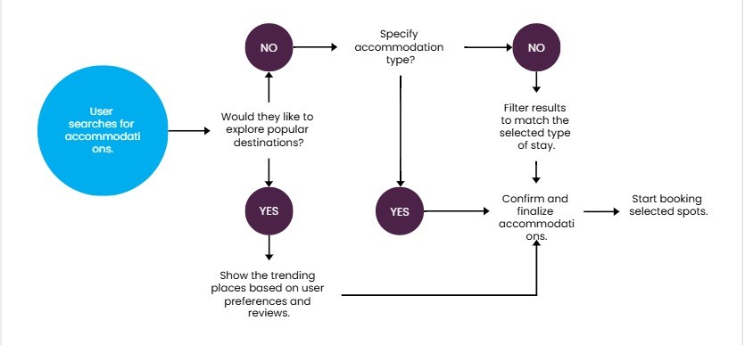
System Design
Figure 1: System Design

Slide 11
Technologies and methodologies
Frontend Technology :
Bootstrap 5
CSS 4.15
HTML 5
Backend technology :
Node.js (JavaScript)
Express.js, EJS (Embedded JavaScript)
Database:
Mongodb

Slide 12
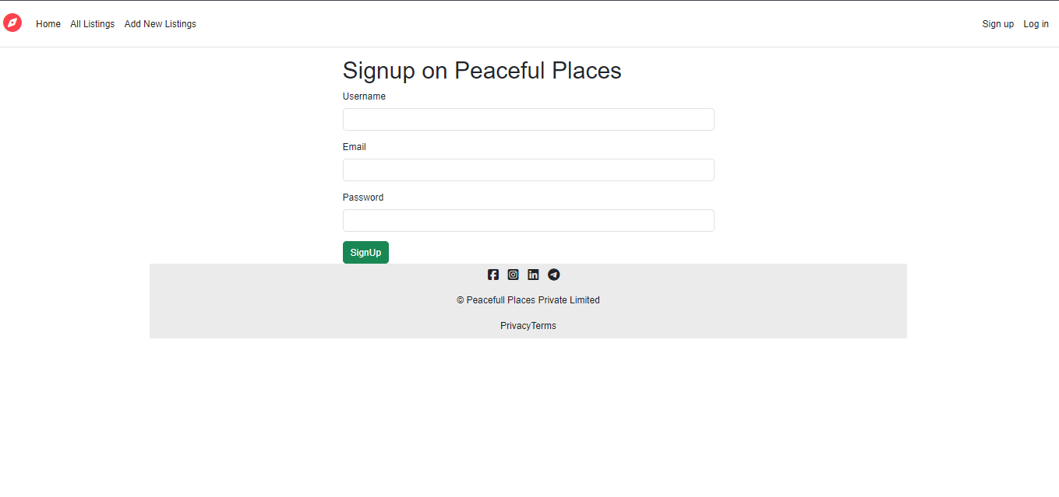

Implementation
Figure 2: Signup page
Figure 3: Login page

Slide 13
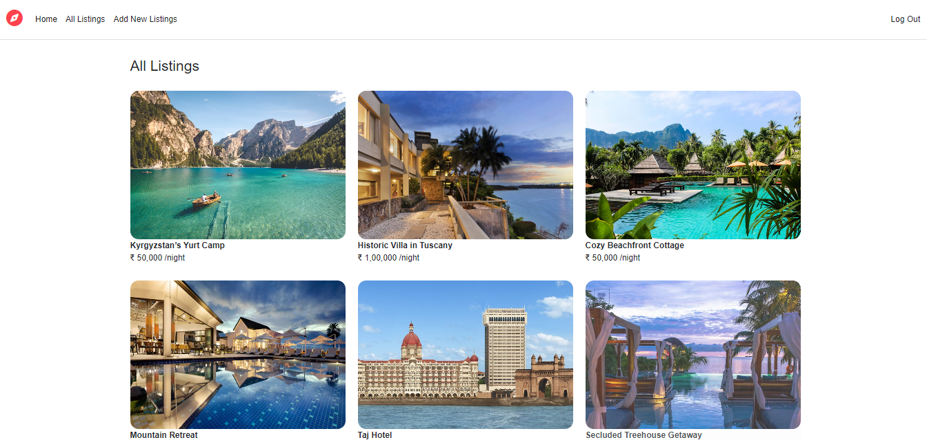

Implementation
Figure 4: All Listings page
Figure 5: Listing Detail page

Slide 14


Implementation
Figure 6: Create a new page
Figure 7: Review page

Slide 15
Conclusion
PeacfulPlaces aims to revolutionize vacation rentals by offering a seamless platform for property searches, personalized recommendations, and efficient bookings. By integrating features like chatbot support, map integration, and sorting based on reviews, PeacefulPlaces will enable users to find the perfect stay that meets their preferences.
This user-friendly approach seeks to enhance the travel experience, support hosts in managing properties effectively, and contribute to a more convenient and enjoyable vacation rental ecosystem.

Slide 16
References
[1]Muhamma Raheel Raza,Walayat Hussain,Asaf Varol,‘Performance Analysis of Deep Approaches on Airbnb Sentiment Reviews ’, June 23,2022.
[2]Viriya Taecharungroj, Boonyanit Mathayomchan,‘Analysing TripAdvisor reviews of tourist attractions in Phuket, Thailand’ , 2019.
[3] Zain ul abedin Janjua,Gengeswari Krishnapillai, Mobashar Rahman, ‘A Systematic Literature Review of Rural Homestays and Sustainability in Tourism’ , April 8 ,2021

Slide 17
Thank You...!!

